Slide 2
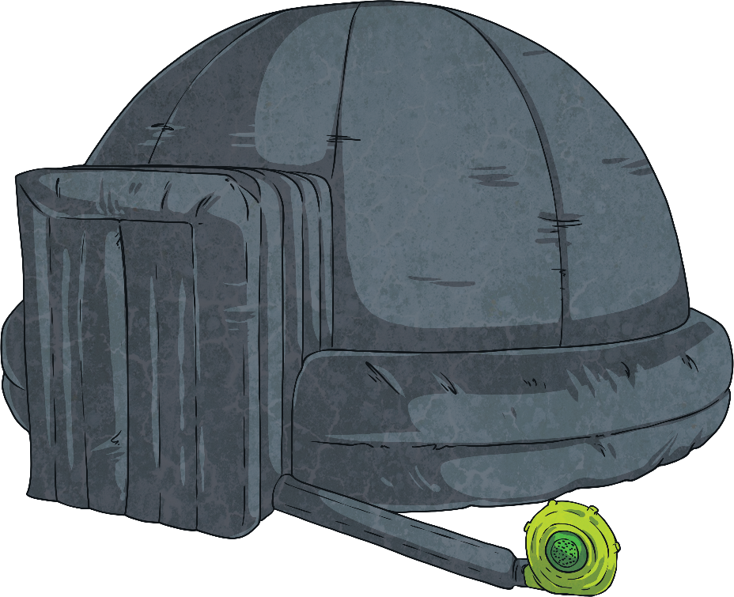
Escape the Planetarium
To help you learn more about Earth and space, your teacher has arranged for a mobile planetarium to come to school. You have an amazing day looking at pictures of stars and planets.
At the end of the school day, you stay to help clear away. The planetarium is so dark and the background music is so relaxing. You sit down and let your eyes close, just for a second…
You glance at your watch and see that it is 4:37. You’ve been asleep for over an hour! You listen for the hustle and bustle of teachers around school, but you hear nothing.

Slide 3
Escape the Planetarium
Stretching your limbs, you walk over to the exit of the planetarium. It is zipped closed. You bend down and tug at the zip, but it won’t budge.
As loudly as you can, you call for help. Nothing. Everyone must have gone home for the day. You are trapped! Fumbling with the zip, you notice a padlock on it. You realise that if you can find out the combination to the padlock, you’ll be able to escape.
Solve the clues and puzzles to discover the combination to the padlock and escape the planetarium. The clues could be anywhere, so you need to keep your eyes peeled and your mind sharp!

Slide 4

Escape the Planetarium
The Rules
You can work in small groups.
When you find a clue, work together to solve the puzzle.
Write your answer down on your answer sheet.
Once you have discovered the combination for the padlock, check it with your teacher to discover if you can escape the planetarium!

Slide 5
Escape the Planetarium
Answers to the Clues

Slide 6

Escape the Planetarium – Clue 1
Starting with the planet closest to the Sun, which is the correct order of the planets?
1.
Mercury, Venus, Mars, Earth, Jupiter, Saturn, Uranus, Neptune
Mercury, Venus, Earth, Mars, Saturn, Jupiter, Uranus, Neptune
Venus, Mercury, Earth, Mars, Jupiter, Saturn, Uranus, Neptune
Mercury, Venus, Earth, Mars, Jupiter, Saturn, Uranus, Neptune
2.
3.
4.
4. Mercury, Venus, Earth, Mars, Jupiter, Saturn, Uranus, Neptune
Number 4 shows the planets in the correct order.
The first digit on the padlock is four.
4

Slide 7
Escape the Planetarium – Clue 2
Look at these sentences about the Earth’s movement in space.
False
It takes the Earth 365 days, or 1 year, to complete one rotation on its axis.
True
The Earth’s axis is at a tilt of 23.5 degrees.
True
The Sun does not rotate or revolve.
False
The sun rises in the west and sets in the east.
True
The Earth revolves round the Sun.
True
The path the Earth takes round the Sun is called its orbit.
When the northern hemisphere of Earth is tilted away from the Sun, people in this area are experiencing summer.
False
There are three false statements.
The second digit on the padlock is three.
3

Slide 8
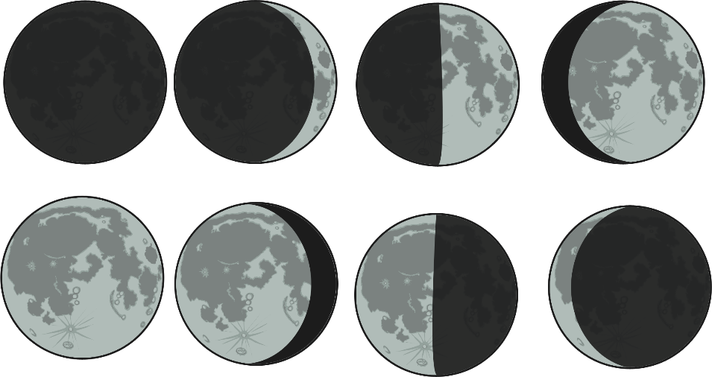


Escape the Planetarium – Clue 3
Read these statements.
waning crescent
full moon
waxing crescent
waxing half moon
waxing crescent
new moon
waning crescent
waxing gibbous
new moon
waning gibbous
waxing gibbous
full moon
waning half moon
waning gibbous
There are six incorrect labels.
The third digit on the padlock is six.
6

Slide 9
Escape the Planetarium – Clue 4
Certain things mean an object in our solar system can be classed as a planet. Which of these criteria are they?
It has to be roughly spherical.
It has to have been discovered by an astronomer.
It has to orbit the Sun.
x
It must not orbit another planet.
It must not be made of gas.
It must have at least one moon.
x
x
It must be big enough to clear away any debris floating near to it.
It cannot be seen in the sky with the naked eye.
It must once have had water on it.
x
x
There are four things needed in order for a body to be classed as a planet. The fourth digit on the padlock is four.
4

Slide 10
Escape the Planetarium – Clue 5
Read the clues about forces and write the answer with one letter in each box.
water
71% of the Earth’s surface is covered in this.
oxygen
21% of the Earth’s atmosphere is made up of this.
solar system
The Earth, other planets and the Sun make up this.
water vapour
When viewed from space, much of Earth is covered in this.
The letters e, n, s, e, v rearranged spells ‘seven’.
The fifth digit on the padlock is seven .
7

Slide 11
Escape the Planetarium – Clue 6
The number of months it takes for the Earth to orbit the Sun
+
The number of days it takes for the Moon to orbit the Earth
+
The number of hours it takes for the Earth to rotate on its axis
Divide this total by 8
12
28
24
12 + 28 + 24 = 64
64 ÷ 8 = 8
The sixth digit on the padlock is eight.
8

Slide 12
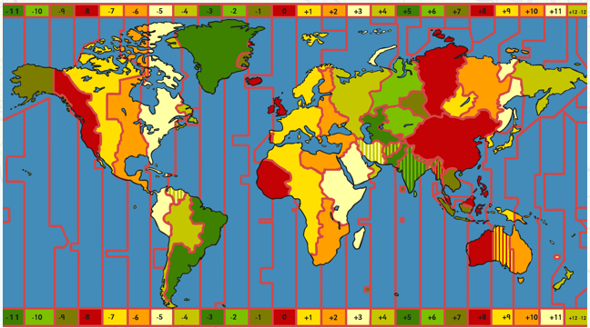
Escape the Planetarium – Clue 7
The rotation of Earth creates different time zones across the world.
Sydney is 10 hours ahead of London. So if it is 11pm in London, it is 9am in Sydney.
The seventh digit on the padlock is nine.
9

Slide 13
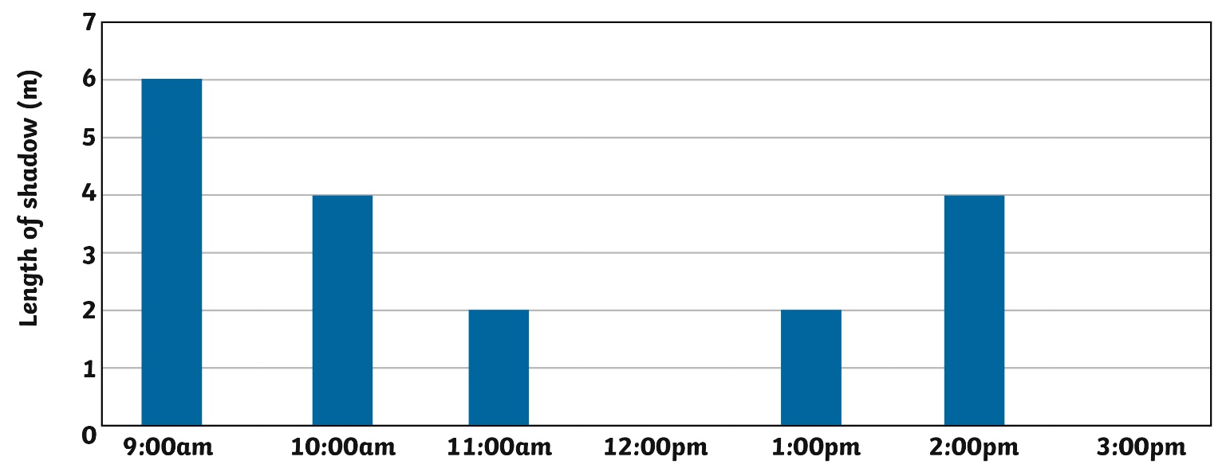
Escape the Planetarium – Clue 8
Due to the rotation of the Earth on its axis, the Sun appears to change position in the sky during the day. (Class 5 know that the Sun doesn’t actually move!) Class 5 did an experiment to show how shadows change length. They recorded their results in a bar chart.
The shadow should be 6 metres, based on the way the shadow changed during the rest of the day.
The eighth digit on the padlock is six.
6

Slide 14
Escape the Planetarium – Clue 9
is a force that pulls objects towards its centre. It is measured in newtons and the strength of it changes with the mass of a planet.
Gravity
The number of letters in the missing word is the ninth digit of the combination for the padlock.
The missing word is gravity and it has seven letters.
The ninth digit on the padlock is seven.
7

Slide 15
Escape the Planetarium – Clue 10
Which of these bodies isn’t classed as a planet?
Jupiter | Earth | Mars | Pluto
Uranus | Venus | Mercury | Saturn
Pluto isn’t classified as a planet. There are five letters in Pluto. The tenth digit on the padlock is five.
5

Slide 16
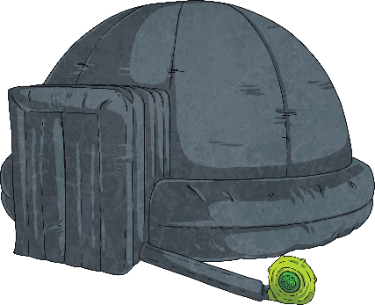

Escape the Planetarium
Now you’ve solved all the clues, it’s time to enter the code into the padlock and escape the planetarium!
Digit
1
Digit
2
Digit
3
Digit
4
Digit
5
Digit
6
Digit
7
Digit
8
Digit
9
Digit
10
?
?
?
?
?
?
?
?
?
?
4
3
6
4
7
8
9
6
7
5
unlock

