Slide 2
Electricity
Talk About It
    Electricity is an important part of everyday life. Look around the room and see how many things you can find that need electricity.
    Clue – these things will have a wire and plug.
Although we use electricity every day, it can be dangerous and we must follow rules to keep ourselves safe.

Slide 3
The Dangers of Electricity
Electricity is energy that can flow from place to place; this is called a current.
This flow of energy is what powers all kinds of things like computers, lights and televisions.
If electrical items are damaged, fires can start.

Slide 4
The Dangers of Electricity
Not being careful around electricity could cause an electric shock.
An electric shock is when an electrical current enters the body. This can make it hard for the person to breathe, it can burn their skin and in the worst case, a person can die from an electric shock.
Talk About It
    How can we be safe around electricity?

Slide 5
Electrical Safety at Home
There are lots of ways to stay safe around electricity when you are at home.
Don’t touch plug sockets. Ask an adult to plug something in for you. Putting your fingers (or another object) in a plug socket, even if the switch is in the off position, can give you an electric shock.
Adults must not plug too many things into one socket as this can cause a fire.
If you notice an electrical wire is damaged, do not touch it and tell a grown-up straight away.

Slide 6
Electrical Safety at Home
Adults should make sure that electrical wires are tucked out of the way so that nobody trips over them. They should never be near the oven.
If a pet chewed on wires, it could get an electric shock.
If wires dangle down, young children could pull them causing appliances, such as microwaves or toasters, to fall and hurt them.
If a piece of bread gets stuck in the toaster, adults must not use knives to try and get the bread out. A knife is metal. Electricity can travel through the metal and give the person holding it an electric shock. What could the adult do instead?
Answer
The adult would need to unplug the toaster before getting the bread out.

Slide 7
Electrical Safety at Home
Don’t touch a light switch with wet hands as it can give you an electric shock. This is why most bathroom lights have pull cords.
Electrical appliances like hair straighteners shouldn’t be used in the bathroom because water and electricity do not mix. Mixing water and electricity can cause an electric shock. Some bathrooms have special plugs so electric shavers can be used safely.
When you leave the house, electrical equipment, such as tumble dryers, shouldn’t be left on. Sometimes they can get too hot and cause a fire.

Slide 8
Electrical Safety at School
Schools do lots of things to make sure children are safe around electricity:
All electrical equipment in school is tested every year by an electrician to make sure it is safe to use.
At schools, electrical equipment is fitted by an electrician. If something needs fixing, this is also done by an electrician.

Slide 9
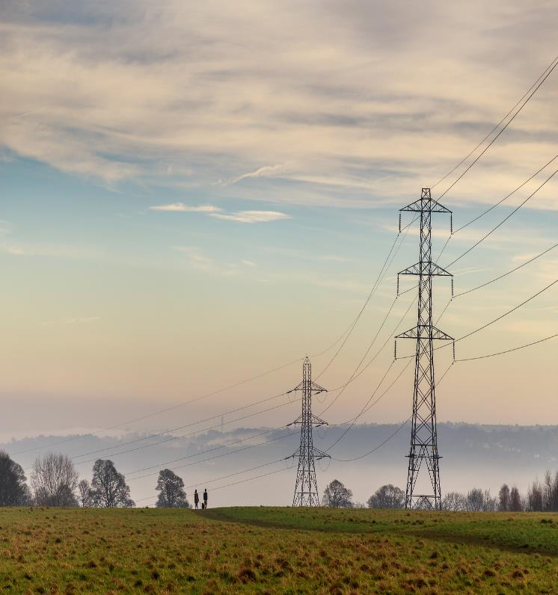
Electrical Safety Out and About
These pylons have thick cables which carry electrical current long distances.
You should never go near a pylon.
Kites should never be flown near pylons or electrical cables.
Why do you think this is?
Answer
  The person holding the kite would get a very serious electric shock as the current here is very strong.

Slide 10
Electrical Safety Out and About
If adults are using electrical equipment outdoors, it must be weatherproof which means it is made to keep the rain out.
Do you remember why this is important?
Answer
  Water and electricity don’t mix!

Slide 11
Electrical Safety Out and About
If you see this sign - keep away. It means there is dangerous electrical equipment nearby.

Slide 12
Electrical Safety Quiz
Electricity is energy that can flow from place to place; this is called a
raisin
sultana
current
c
Answer

Slide 13
Electrical Safety Quiz
2. Which of these items uses electricity?
fridge
television
microwave
Answer
all of them

Slide 14
Electrical Safety Quiz
You can get an electric if you are not careful around electricity.
fright
shock
scare
Answer
b

Slide 15
Electrical Safety Quiz
Why must an adult never put a metal knife in a toaster?
If the toaster is plugged in, it can give the person an electric shock.
It will scratch the toaster.
It will damage the toast.
a
Answer

Slide 16
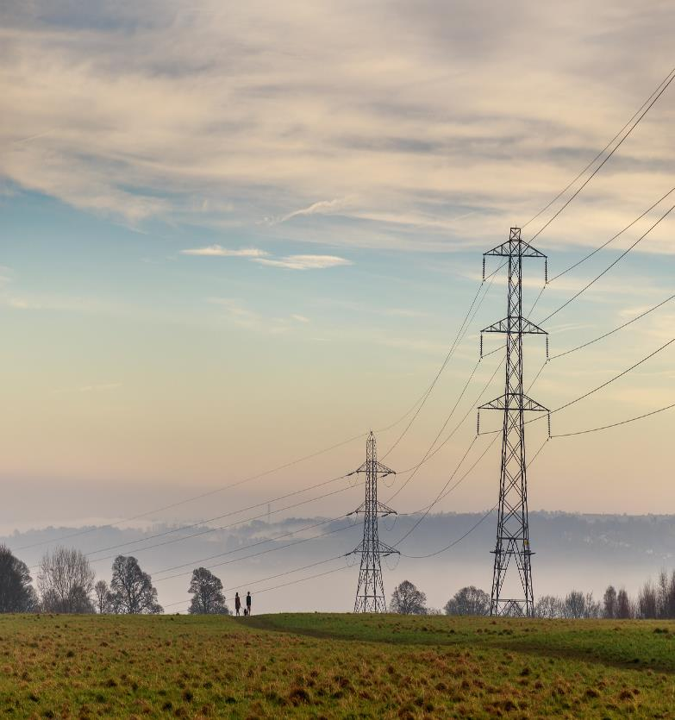
Electrical Safety Quiz
What is this called?
pylon
Answer

Slide 17
Electrical Safety Quiz
If an adult is using electrical equipment outside, it must be…
colourful
waterproof
expensive
Answer
b

