Slide 1



Essential Letters and Sounds
The Phonics Screening Check

Slide 2

Getting all children
to read well, quickly
Notes:
Welcome to our session this evening on Essential Letters and Sounds, or ELS.
We are proud here at Oxford University Press to have partnered with Knowledge Schools Trust English Hub to present an exciting new Systematic Synthetic Phonics programme, Essential Letters & Sounds.
ELS is an affordable, easy-to-use, DfE validated phonics programme that gets all children reading quickly which means that schools who currently follow the L&S progression can adopt this programme with minimum of fuss and low financial investment.
ELS has been carefully named –the programme distills Letters and Sounds to its purest form, to ensure every phonics lesson has the highest quality teaching possible, creating an SSP where only the essential elements are used. The name reflects the key principles of the programme - simplicity and consistency.
We’re delighted to say that the DfE has approved ELS in the first validation window! It meets all criteria for an effective SSP and is eligible for funding from English Hubs.

Slide 3


What are we going to cover?
What is the PSC and why was it introduced?
What does it check?
What are the allowances?
How ELS supports children to achieve the outcomes of the PSC
Preparing for the Phonics Screening Check

Slide 4
What is the PSC?
Phonics Screening Check is a statutory assessment conducted in the Summer Term of Year One.
Introduced in 2011, to ensure that all children have learnt phonic decoding to an age-appropriate standard.
The aim of the PSC was to encourage all schools to pursue a rigorous phonics programme for all children from the start of primary school.

Slide 5
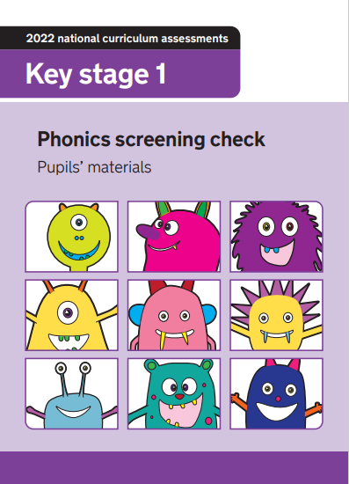

What does the PSC assess?
40 words
Section 1: 8 real words and 12 pseudo words
Section 2: 12 real words and 8 pseudo words

Slide 6

Key Information
Pseudo words, are not real words. In the assessment, these words will have an alien image next to them.
All accents will be taken into account when the child is answering.
Any pronunciation difficulties will be taken into account.
Your child’s final answer is what we will take.

Slide 7

How does ELS support the PSC
We focus on teaching children to read and to have access to books and text.
ELS teaches children vocabulary and ensures that children have meaning and context for language.
Teachers accuracy, fluency and confidence.
Accurate assessment ensures that you know where every child is.

Slide 8


How can you help at home?
Listen to your child read 3 times a week minimum
Watch the online pronunciation videos
If your child is finding it hard to read a word, help them break words down into individual sounds and then blend them together to read the word.

Slide 9

Phonic Readers
Questions
Notes:
All books that align to L&S 2007 can be used with ELS.
You may even have some of our OUP decodables in school.
Should you wish to top up or have a complete refresh of decodable books, our collection align with complete fidelity to ELS

